Slide 1

Invazívne fungálne infekcie –
Quo vadis 2019
Pavol Jarčuška

Slide 2
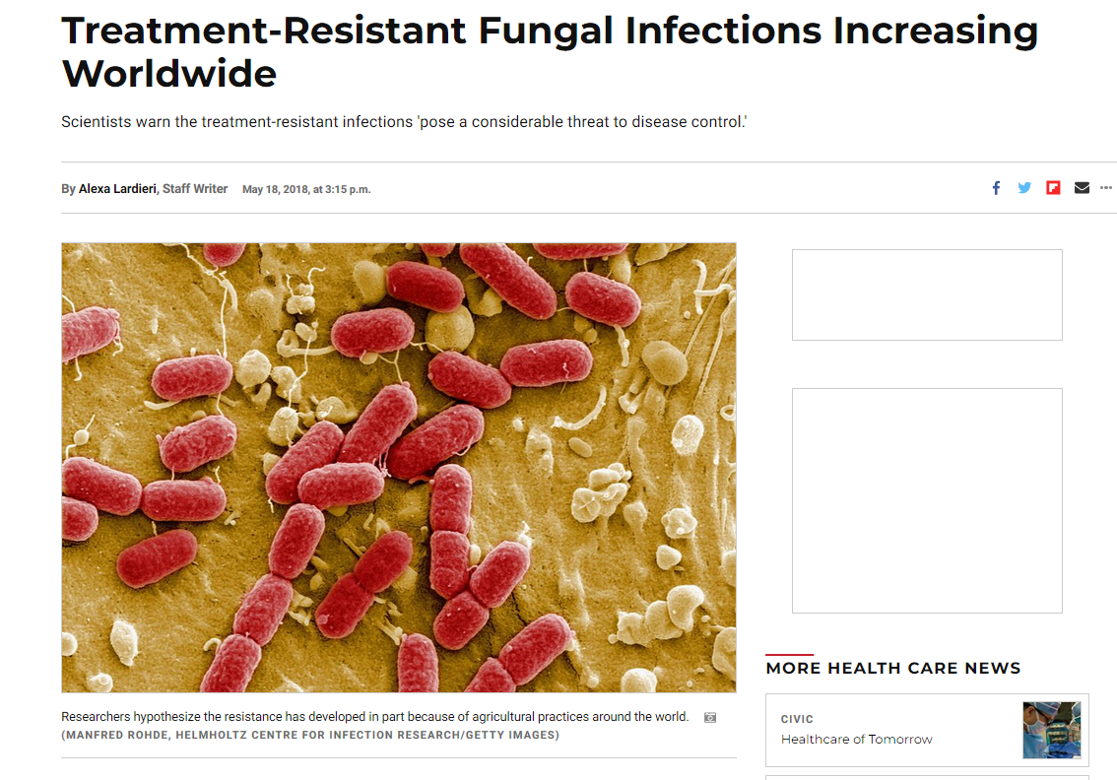

Slide 3

Worldwide emergence of resistance to antifungal drugs challenges human health and food security
by Matthew C. Fisher, Nichola J. Hawkins, Dominique Sanglard, and Sarah J. Gurr
Science
Volume 360(6390):739-742
May 18, 2018
Published by AAAS

Slide 4
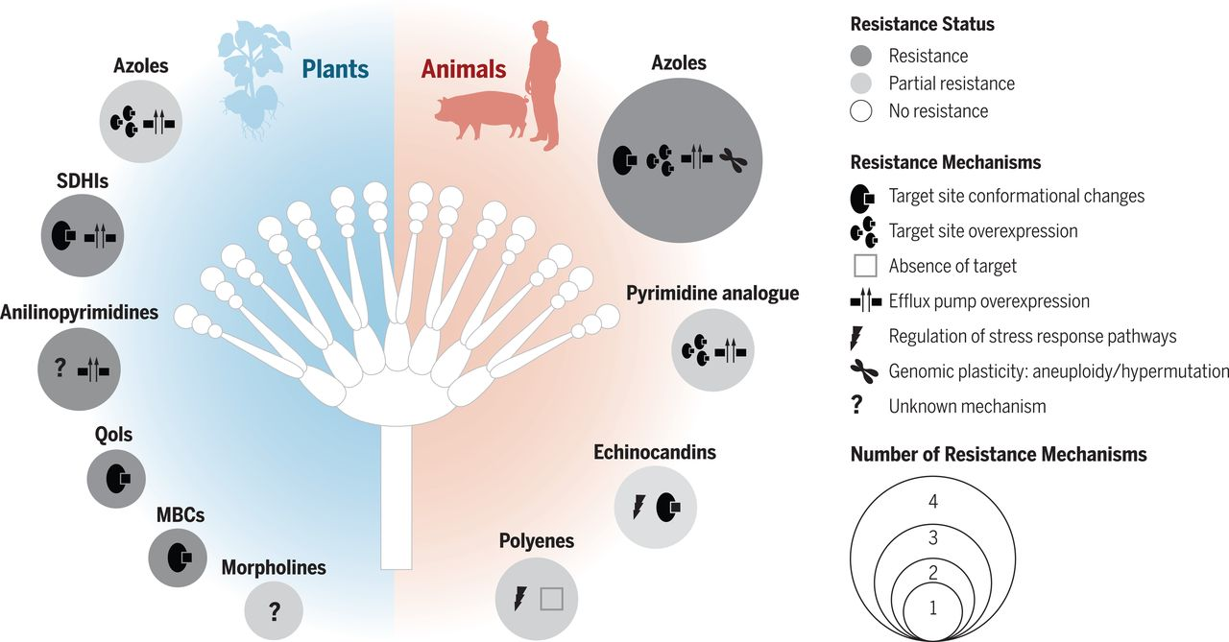
Fig. 1 Current classes of drugs used against plant and animal fungal infections and known mechanisms of resistance to them.
Matthew C. Fisher et al. Science 2018;360:739-742
Published by AAAS
Notes:
Current classes of drugs used against plant and animal fungal infections and known mechanisms of resistance to them. The six main classes of fungicides are the morpholines, which inhibit two target sites within the ergosterol biosynthetic pathway, Δ14-reductase and Δ8-Δ7-isomerase (this reduces the risk of target-site resistance, but their intrinsic antifungal activity spectrum is narrower than those of other antifungals); the azoles (used also in animal infections), which target the ergosterol biosynthetic pathway; the benzimidazoles (MBCs), which interfere with the cytoskeleton by binding to β-tubulin, thus preventing the assembly of microtubules; the strobilurins (QoIs) and succinate dehydrogenase inhibitors (SDHIs), which both inhibit the electron transfer chain of mitochondrial respiration, with the SDHIs inhibiting complex II (succinate dehydrogenase) and the QoIs inhibiting complex III (the quinone outside binding pocket of cytochrome b); and the anilinopyrimidines, which may target mitochondrial signaling pathways. Three other antifungal classes are used for animal fungal infections: the echinocandins, which inhibit cell wall biosynthesis; the pyrimidine analogs, which interfere with nucleic acid biosynthesis; and the polyenes, which bind ergosterol.

Slide 5
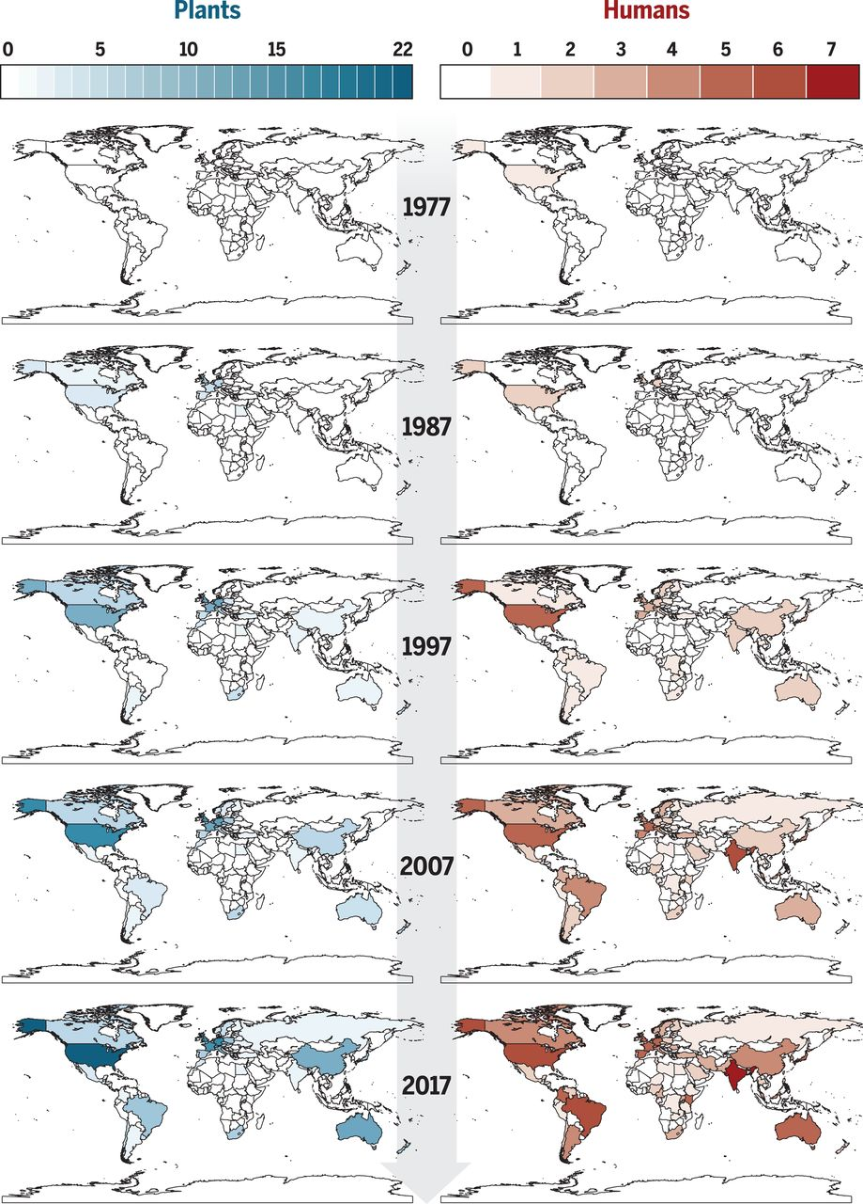
Fig. 2 Fungal species with reported antifungal resistance, by country.
Matthew C. Fisher et al. Science 2018;360:739-742
Published by AAAS
Notes:
Fungal species with reported antifungal resistance, by country. Increasing color intensity reflects a growing number of reports. The plant maps depict spatiotemporal records of resistance of crop pathogens to azoles (blue scale). The human maps depict spatiotemporal records of resistance of the pathogens A. fumigatus, C. albicans, C. auris, C. glabrata, Cryptococcus gattii, and Cryptococcus neoformans to azoles (red scale). The data are derived from peer-reviewed publications as of March 2018, reporting the occurrence of cases of resistance up to 2017 (the list of publications is available in table S1).

Slide 6
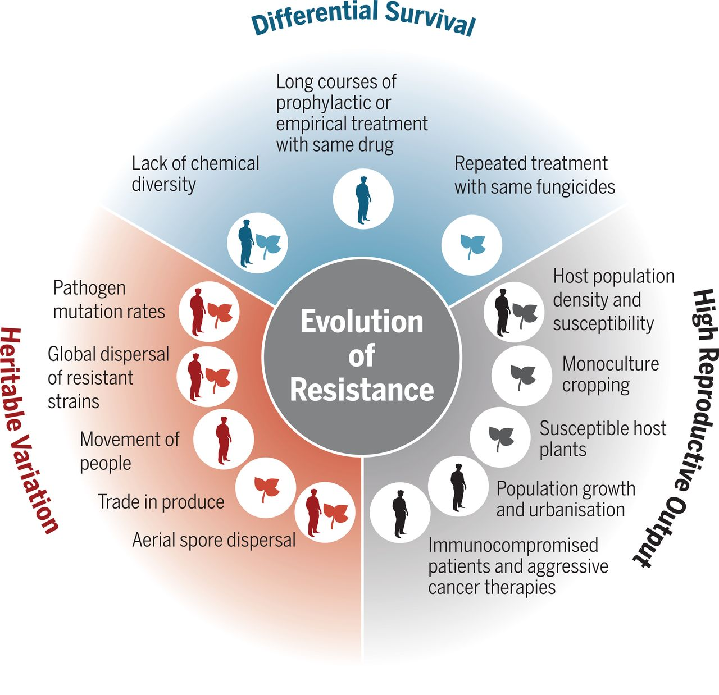
Fig. 3 Evolutionary drivers of antifungal resistance: heritable variation, high reproductive output, and differential survival.
Matthew C. Fisher et al. Science 2018;360:739-742
Published by AAAS
Notes:
Evolutionary drivers of antifungal resistance: heritable variation, high reproductive output, and differential survival.

Slide 7
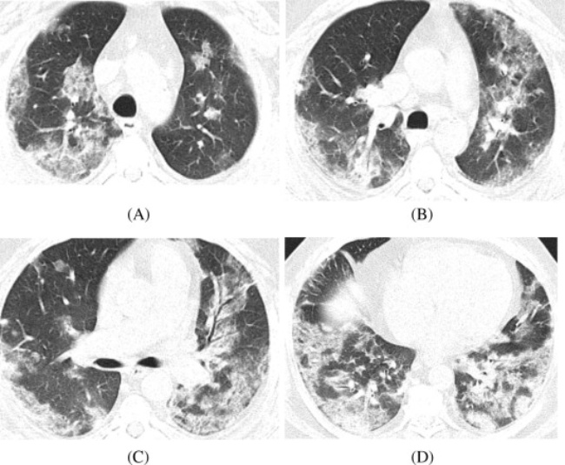
Ak by ste videli taký CT scan
...na čo by ste mysleli?

Slide 8
Je to pacient
S chrípkou H1N1

Slide 9
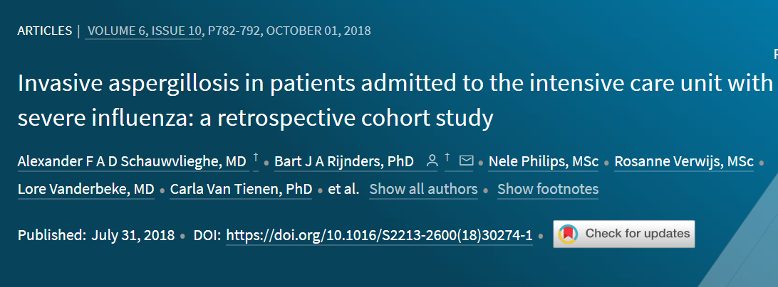

Slide 10
Aspergilóza u pacientov so závažnou chrípkou
Všeobecná populácia
Imunokompromitovaní pacienti
432 pacientov s chrípkou
83 pacientov s aspergilózou
19%
117 pacientov s chrípkou
38 pacientov s aspergilózou
32%

Slide 11
Epidémia chrípky 2009 - 2010
Úmrtia ťažká chrípka - Košice
Aspergilóza
32
0

Slide 12
Epidémia chrípky 2009 – 2010
Ako to asi bolo?
Úmrtia ťažká chrípka - Košice
Aspergilóza
32
10

Slide 13
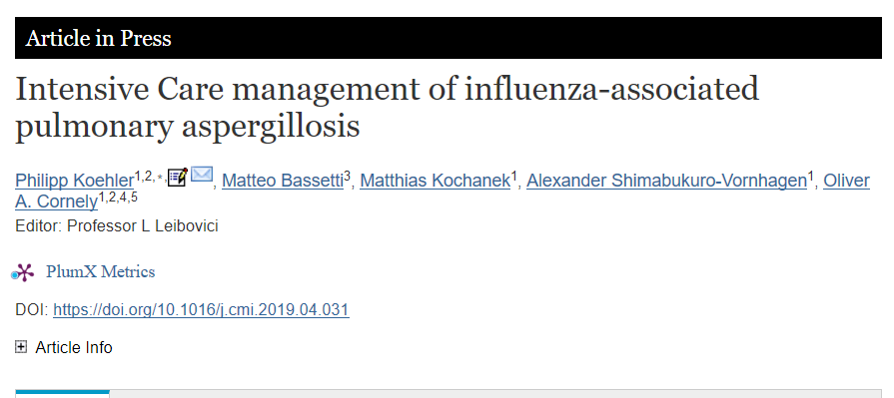

Slide 14
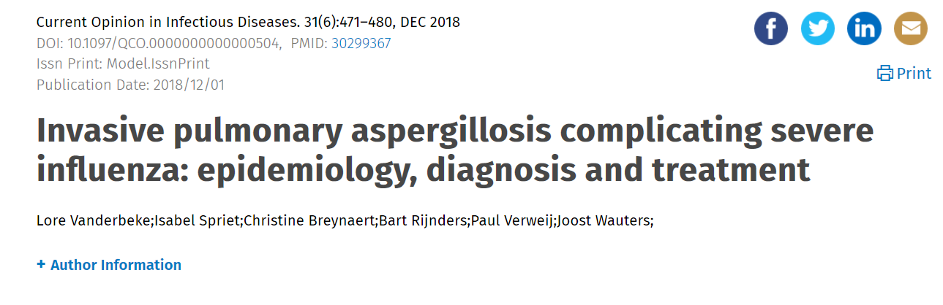

Slide 15
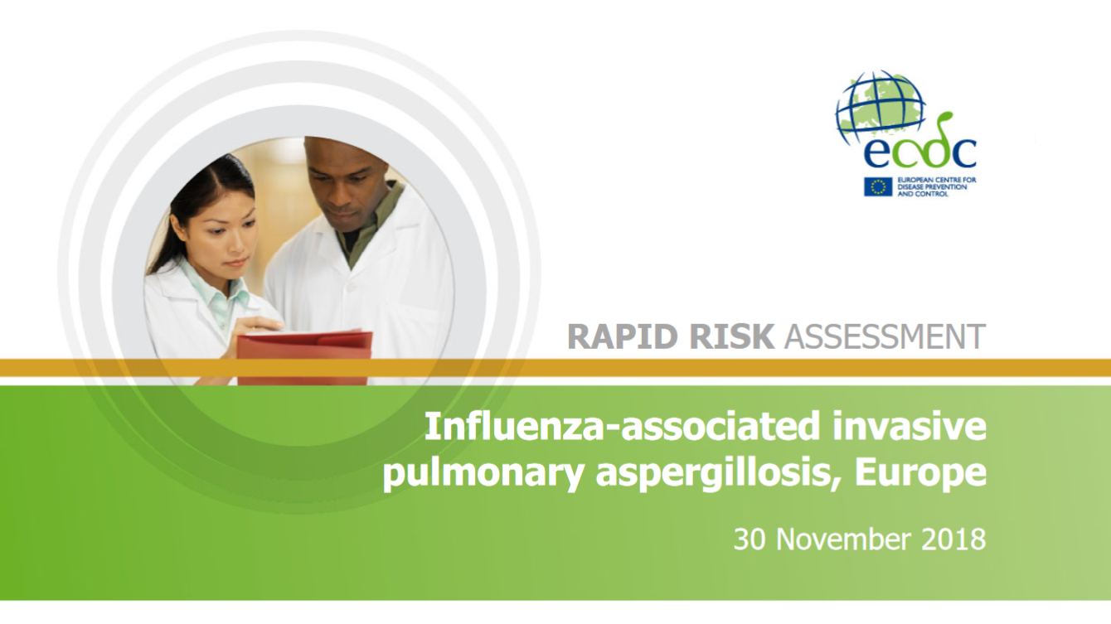

Slide 16
Influenza – associated aspergillosis
Diagnostika
Liečba
Dôkaz H1N1 (event. inej chrípky) – PCR
HRCT
galaktomanán
ECMO
Inhibítory neuaminidázy
Isavukonazol/vorikonazol/ lip. Ampho B
+ ostatná liečba

Slide 17
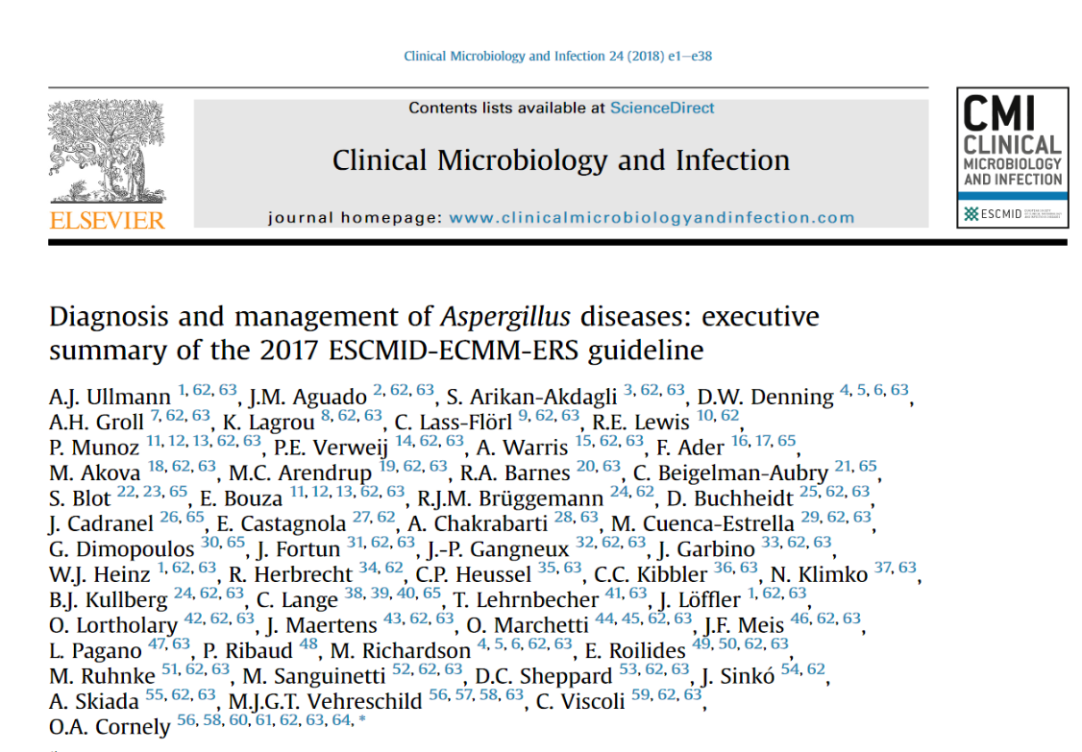

Slide 18
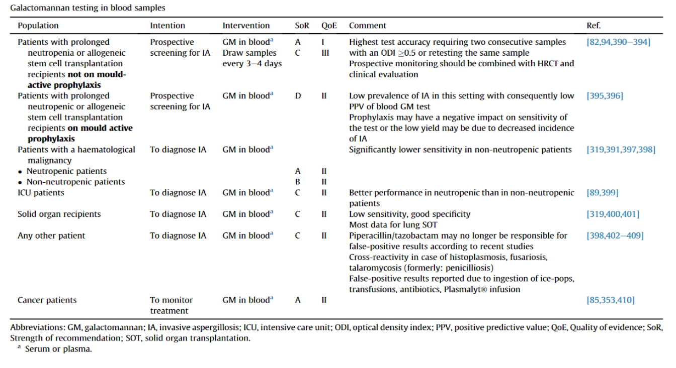

Slide 19
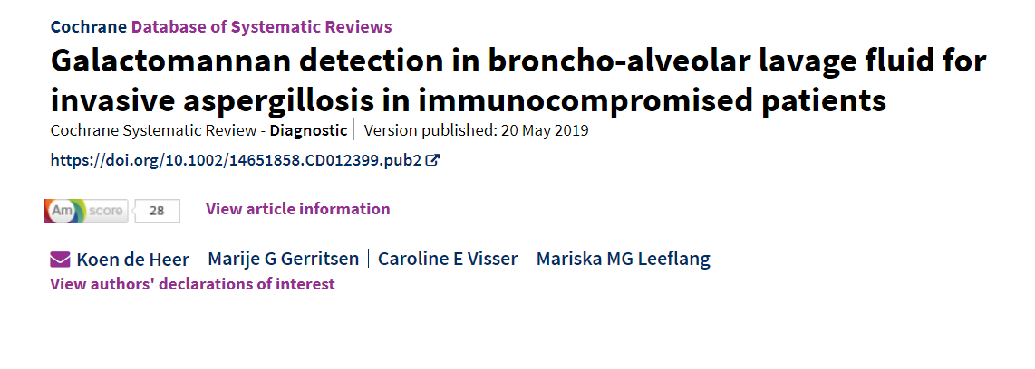
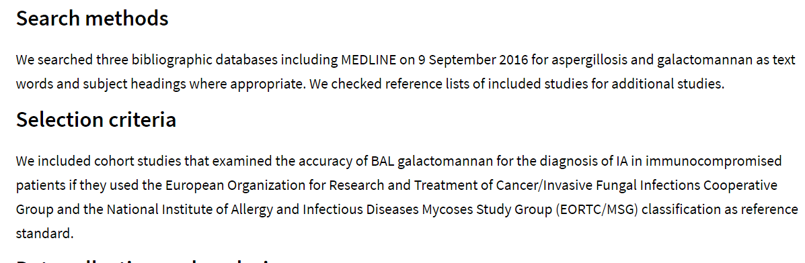

Slide 20
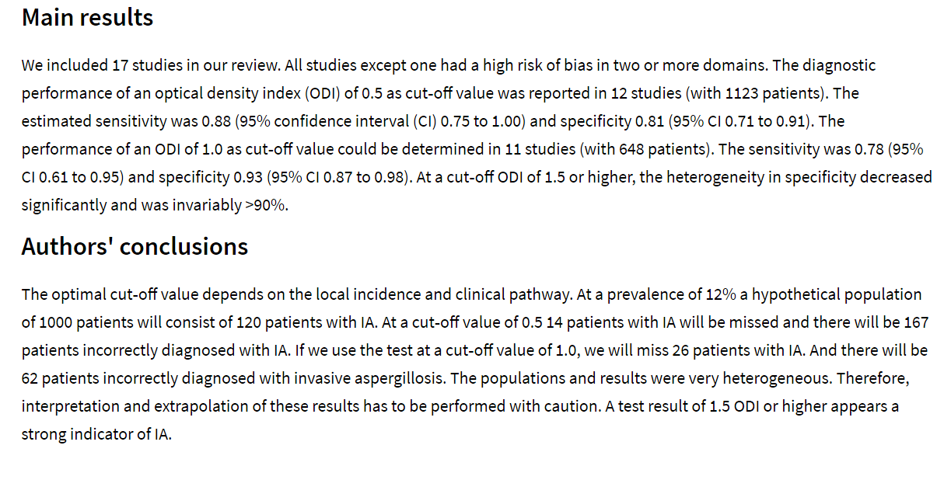

Slide 21
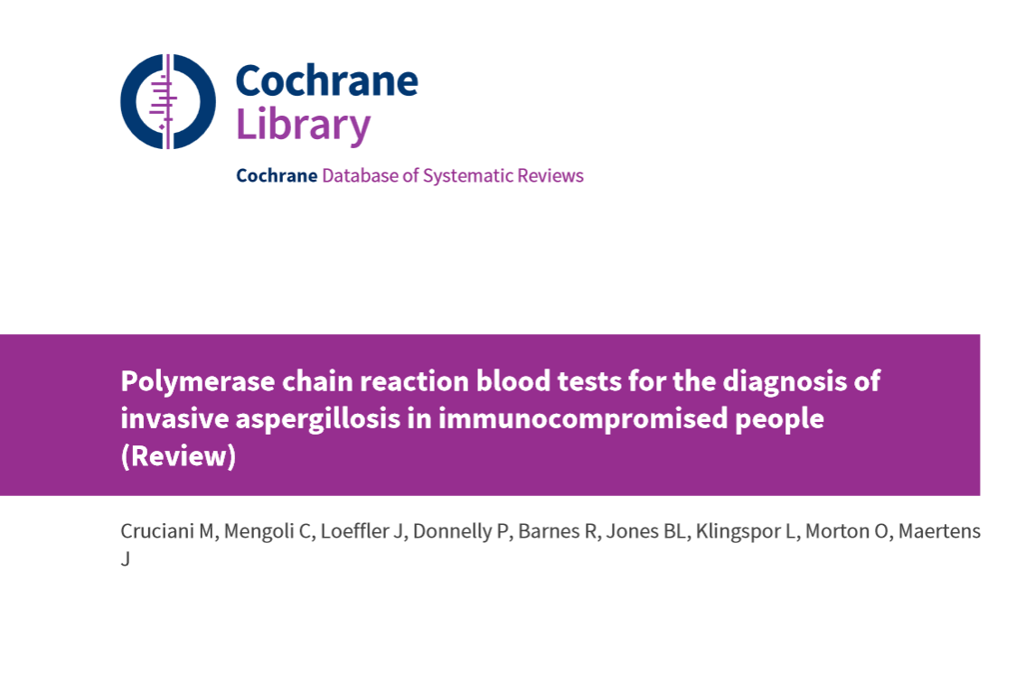

Slide 22
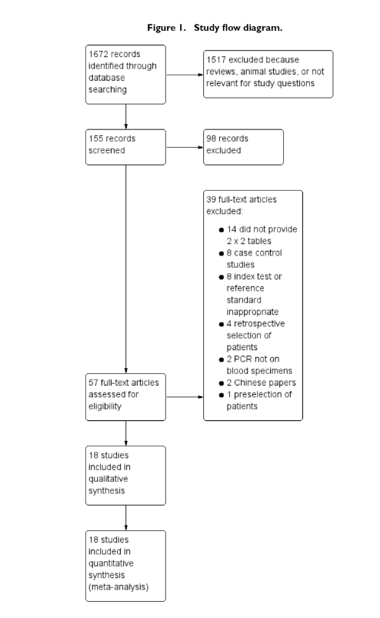

Slide 23
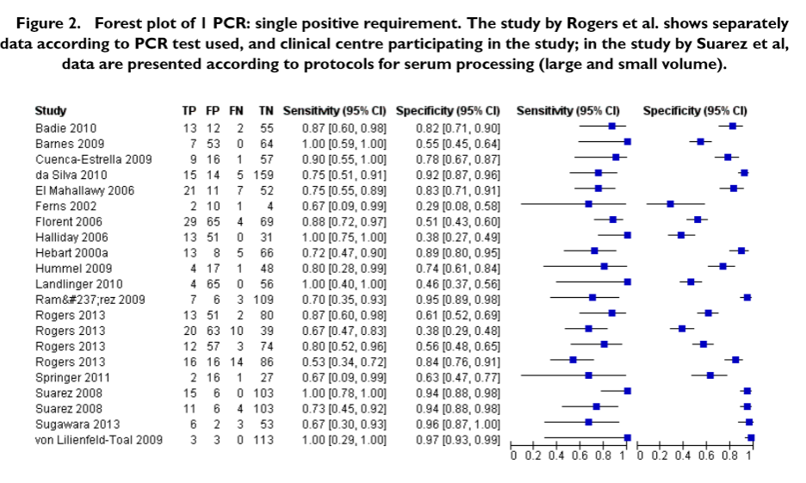

Slide 24
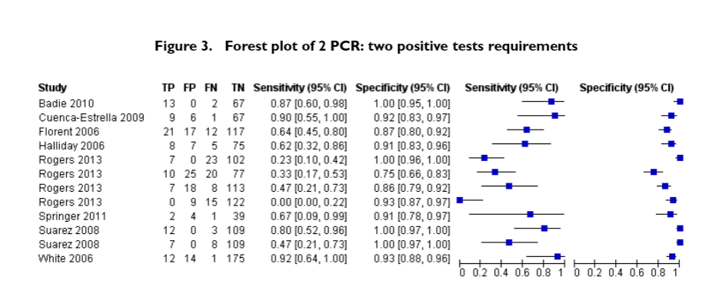

Slide 25
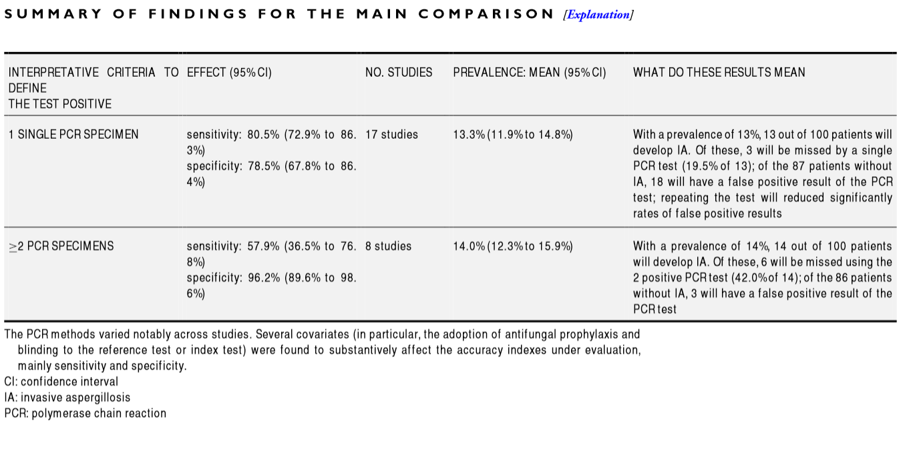

Slide 26
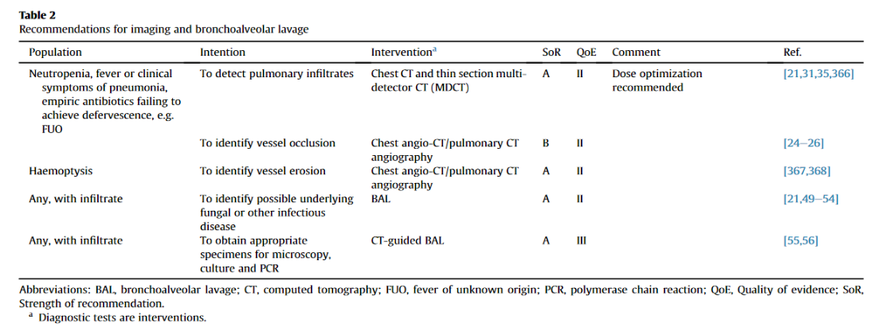

Slide 27
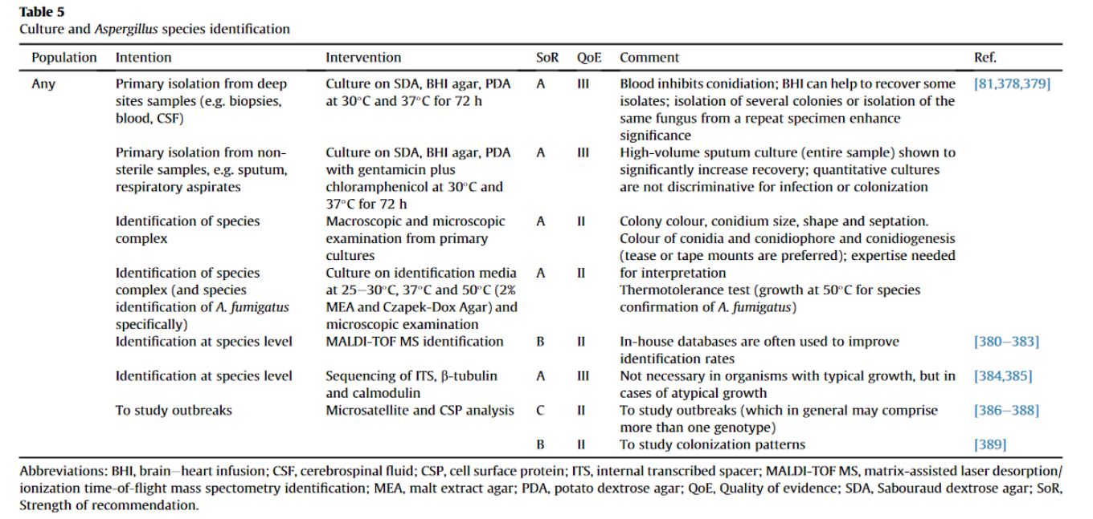

Slide 28
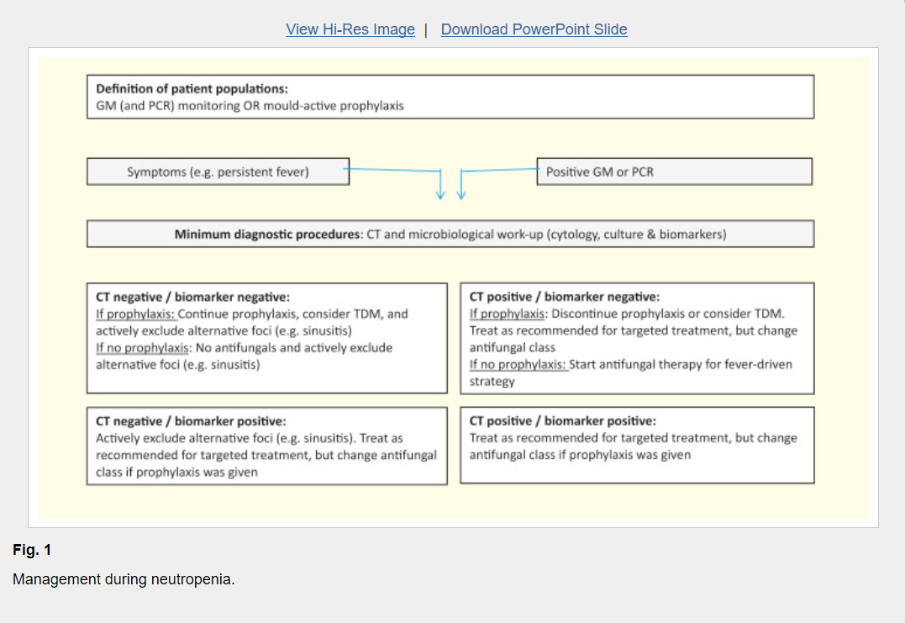

Slide 29
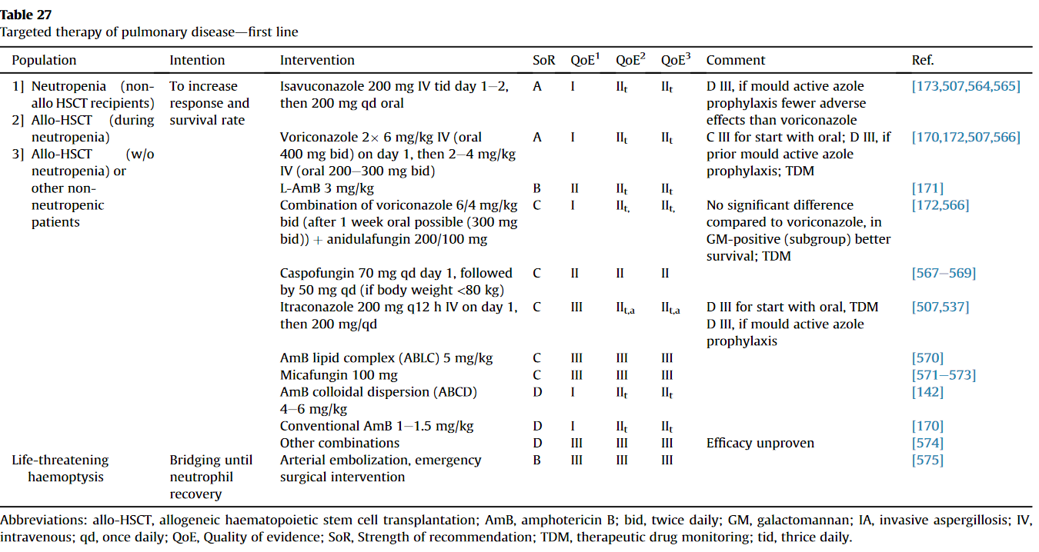
Hematologické pacienti – pľúcne infiltráty

Slide 30
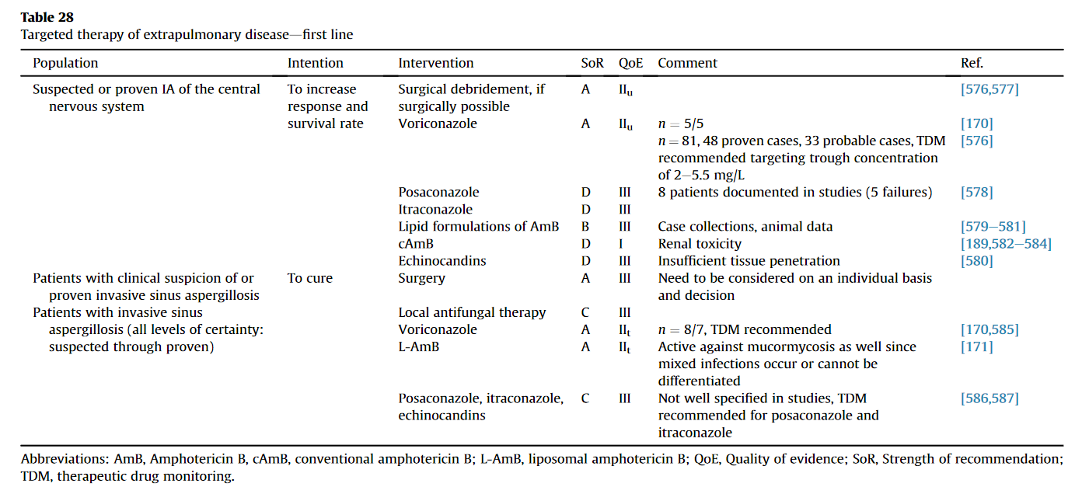
Hematologickí pacienti bez pľúcnych infiltrátov

Slide 31
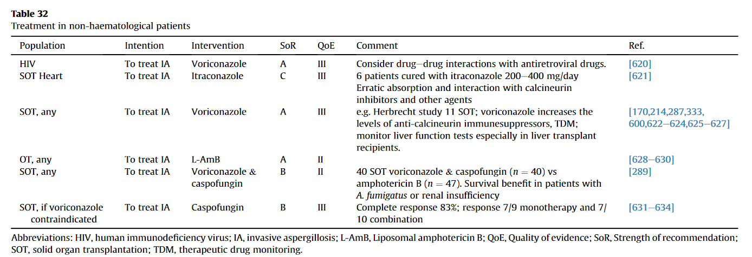
Orgánové transplantácie HIV liečba

Slide 32
Biologická liečba a mykotické infekcie

Slide 33
Anti TNF /TNF solubilný receptor CD4

Slide 34
Čo rozhoduje o ďalšej prognóze pacienta?
CD4 + Nadir
Viete čo to je?

Slide 35
Anti TNF / TNF solubilné receptory
Zníženie počtu CD4 lymfocytov
Zníženie kvality CD4 lymfocytov
Presun k TH2 imunitnej odpovedi
Pseudo AIDS syndróm – tie isté oportunistické infekcie ako pri HIV
- TBC
Intracelulárne oportunistické infekcie
Nedokonalá obrana pred prvokmi a hubami
Infekcie spojené s invazivitou baktériového púzdra

Slide 36
Priebeh HIV infekcie v závislosti od CD4 lymfocytov – baktériové infekcie
Bacterial skin infection
Herpex simplex, zoster
Oral, skin fungal infections
800
600
Thrombocytopenia Lymphadenopathy
500
Kaposi’s sarcoma
400
400
300
CD4 cell count /mm³
Hairy leukoplakia
Tuberculosis
200
PCP
Lymphoma
200
Cryptococcosis
Toxoplasmosis
100
CMV
0
MAC
Months
Years
Notes:
36
CD4 cell counts are commonly used clinical markers
CD4 count is not a perfect clinical marker - the patient’s clinical status and
HIV RNA determinations should always be taken into account.
Course of HIV disease progression as it relates to CD4 count
CD4 cell count reflects the damage sustained by the immune system as a result of the body’s infection by the virus. In conjunction with HIV RNA viral load testing, it can provide useful information about disease progression and clinical status.
It is useful in decisions concerning antiretroviral therapy and risks for OIs.
MAC, Toxoplasma gondii and CMV are rare when CD4 cells >50
PCP, cryptococcosis are unusual when CD4 cells >200.
Slide 25b

Slide 37


Slide 41
UNLP Košice – systémové choroby spojiva a IFI (2013 – 2016)
5 prípadov asperilových IFI (3 anti TNF)
2 prípady invazívnej kandidovej BSI infekcie
5 žien /2 muži
4xSLE,1xRA,1xDM, 1x M.Bechterev
5 pacientov zomrelo

Slide 42
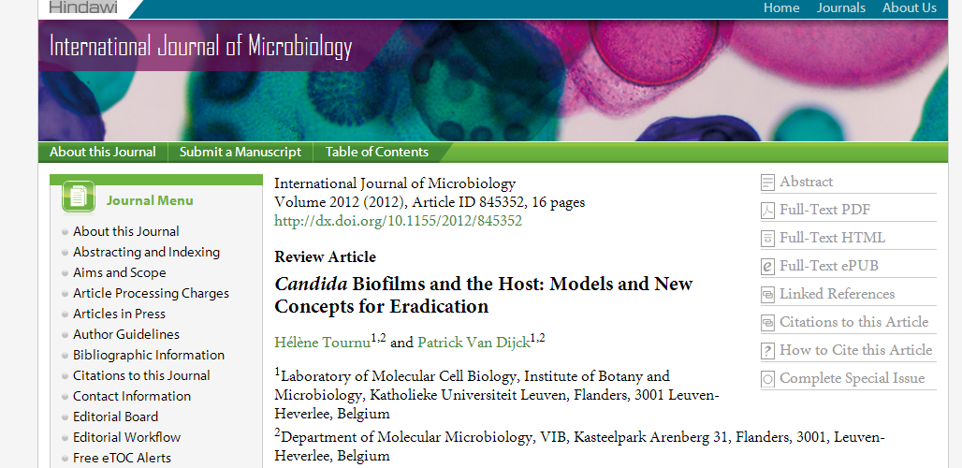

Slide 43
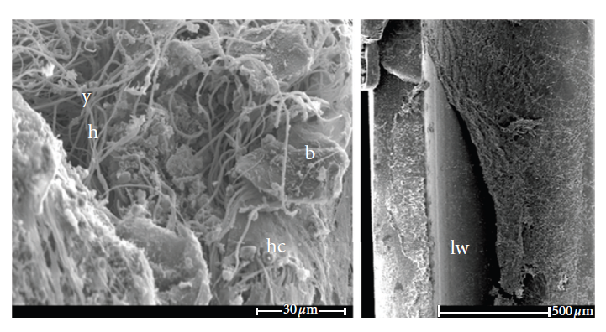

Slide 44
Kandidové (aspergilové) infekcie
Biofilm produkujúce
Kandidové infekcie krvného prúdu
BF- CSBI
Biofilm neprodukujúce
Kandidové infekcie krvného prúdu
NBF CSBI

Slide 45
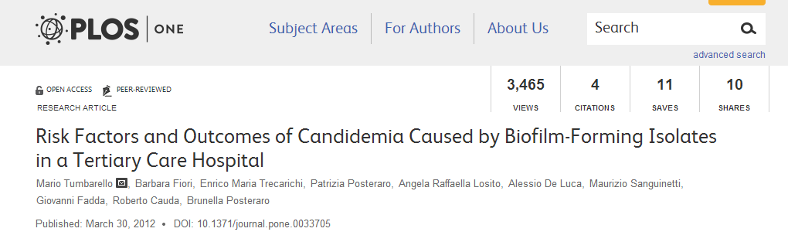

Slide 46
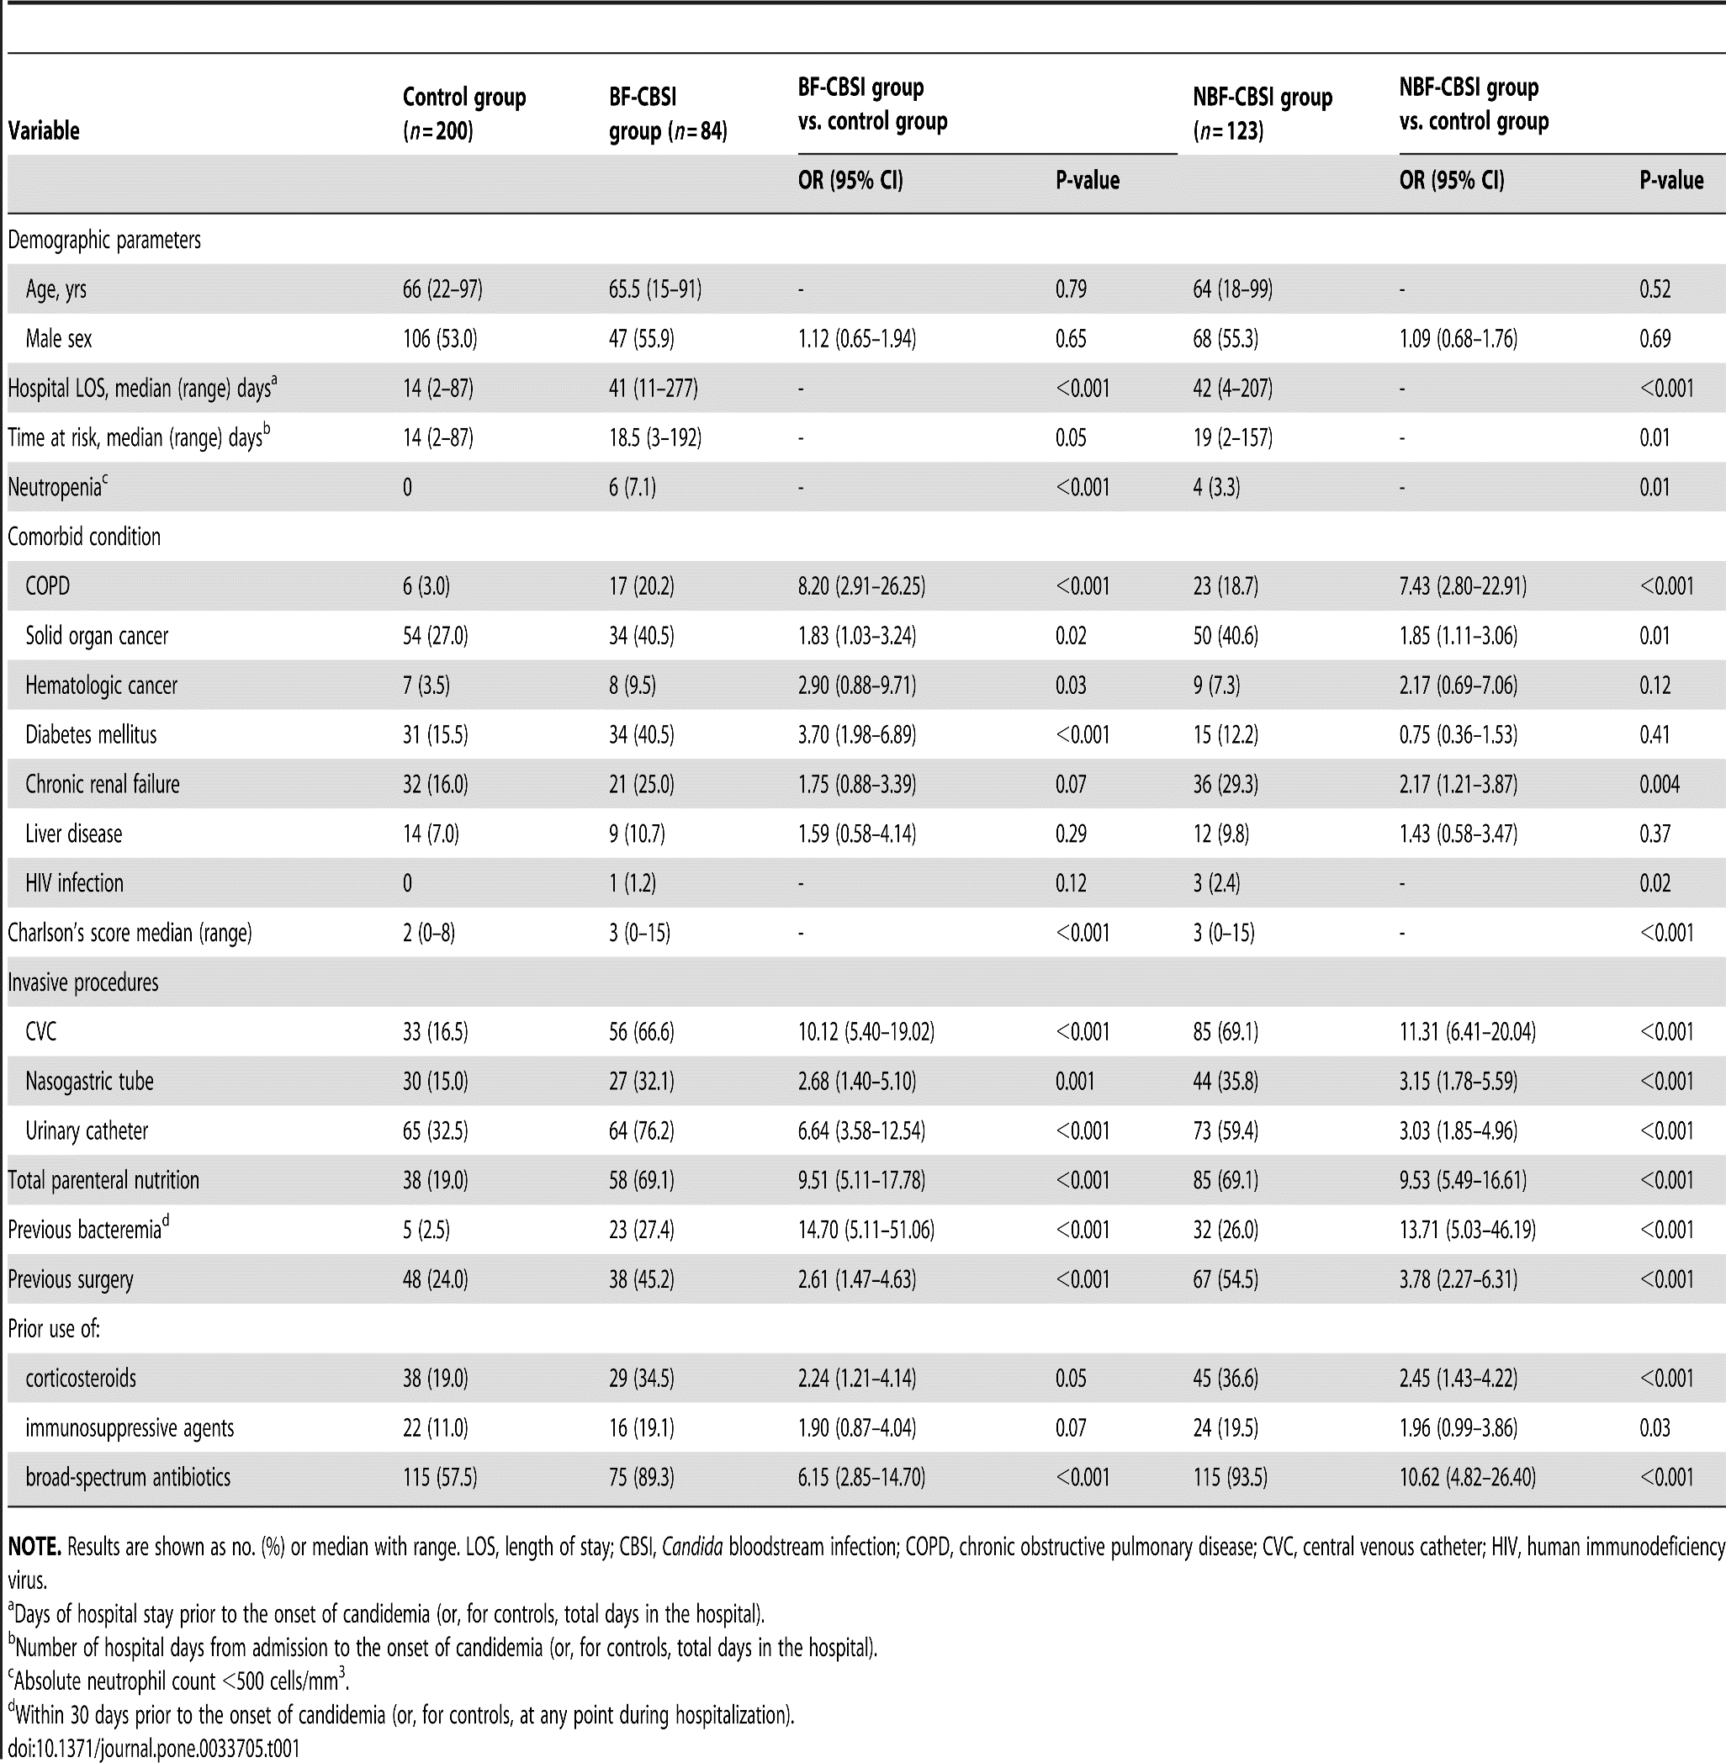

Slide 47
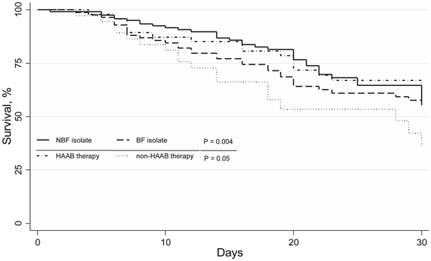

Figure 1. Survival among patients with Candida bloodstream infection (CBSI) at 30 days.
Tumbarello M, Fiori B, Trecarichi EM, Posteraro P, et al. (2012) Risk Factors and Outcomes of Candidemia Caused by Biofilm-Forming Isolates in a Tertiary Care Hospital. PLoS ONE 7(3): e33705. doi:10.1371/journal.pone.0033705
http://www.plosone.org/article/info:doi/10.1371/journal.pone.0033705

Slide 48
Nevýhody biofilm produkujúcich CSBI
Produkcia biofilmu je spojená s horšou prognózou pacienta
Bakteriálna „koinfekcia“ - zápasí o biofilm a uvoľňuje kandidy do krvného obehu, čo „spôsobuje väčšiu fungálnu nálož a zhoršenie prognózy pacienta“

Slide 49
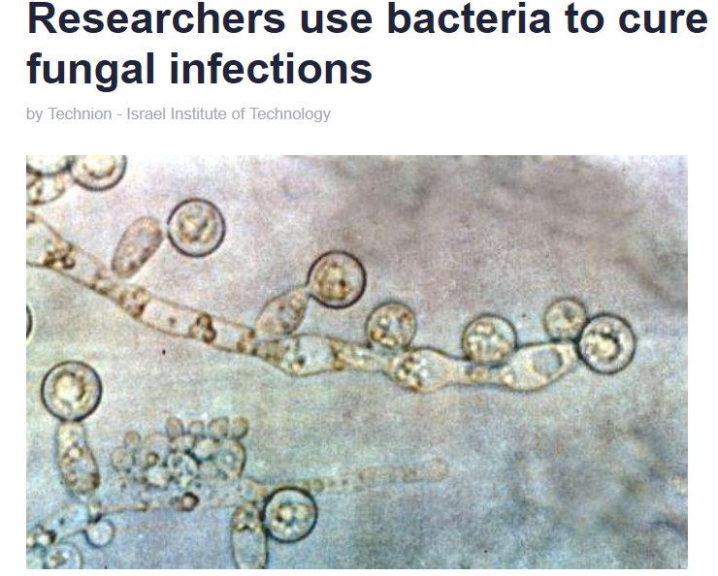

Slide 50
Inhibícia rastu kandíd
produktmi Bacillus subtilis

Slide 51
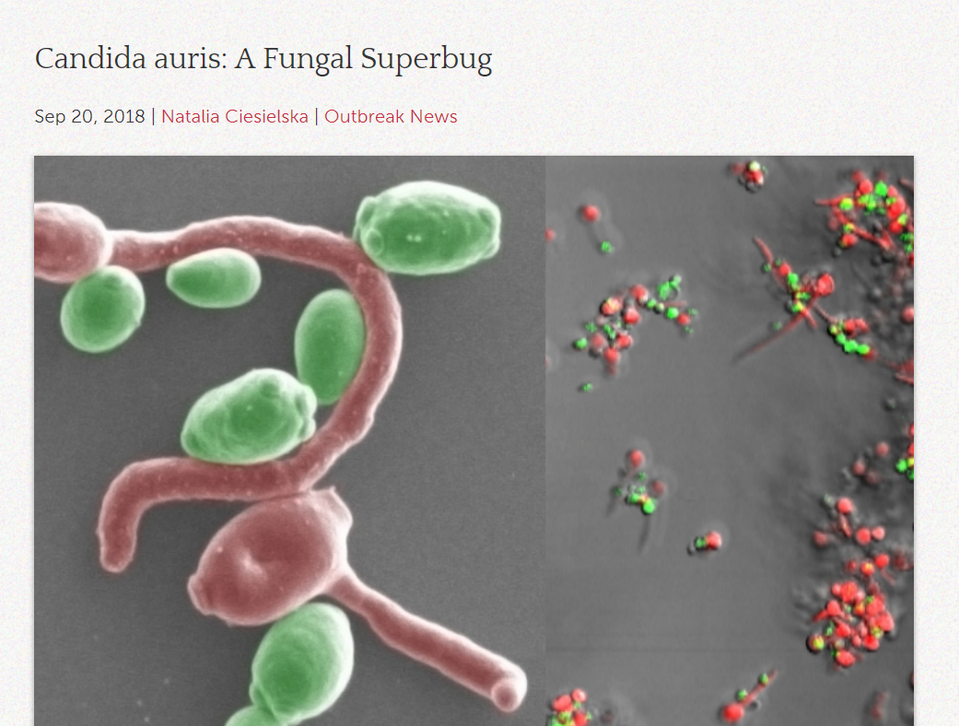

Slide 52
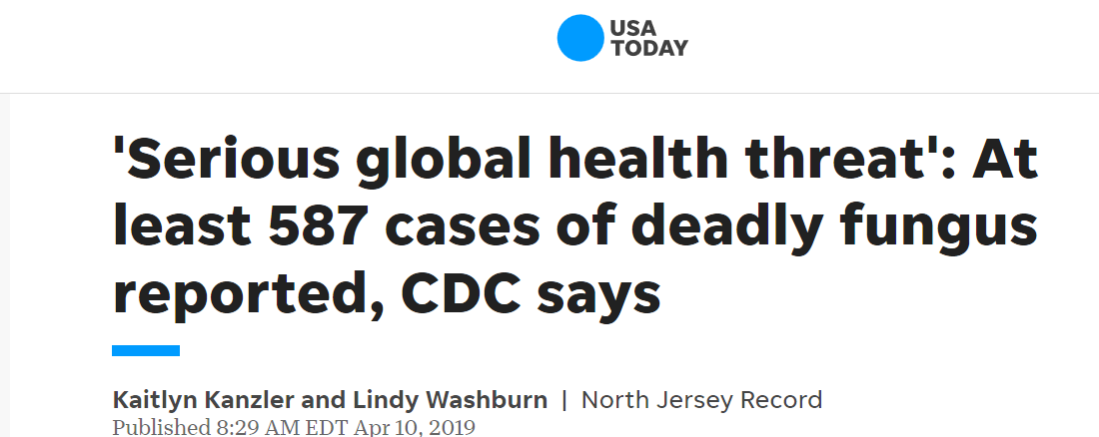

Slide 53
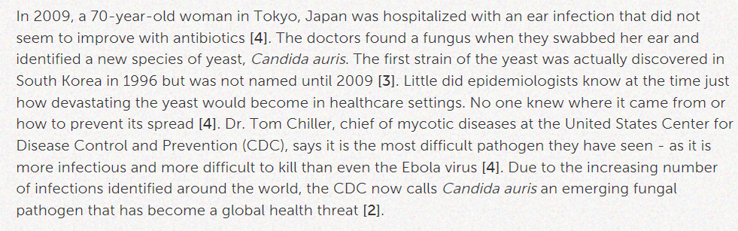
Candida auris 1996 -2009

Slide 54
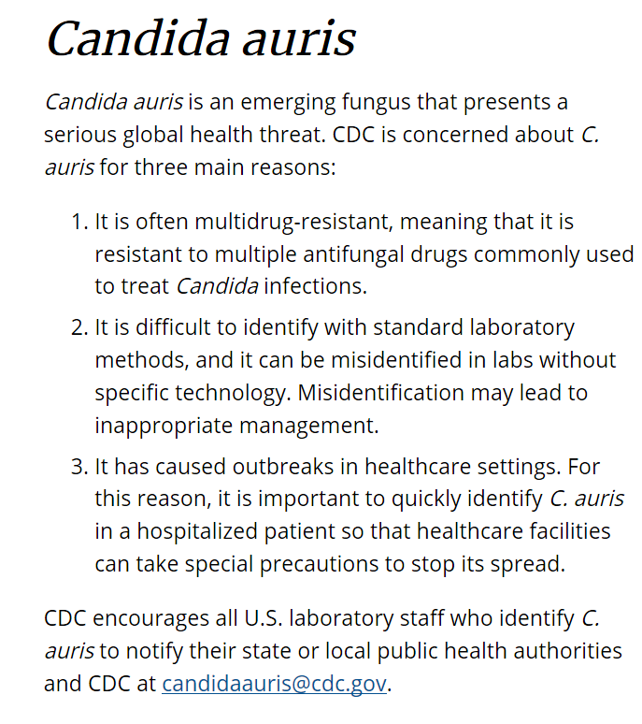

Slide 55
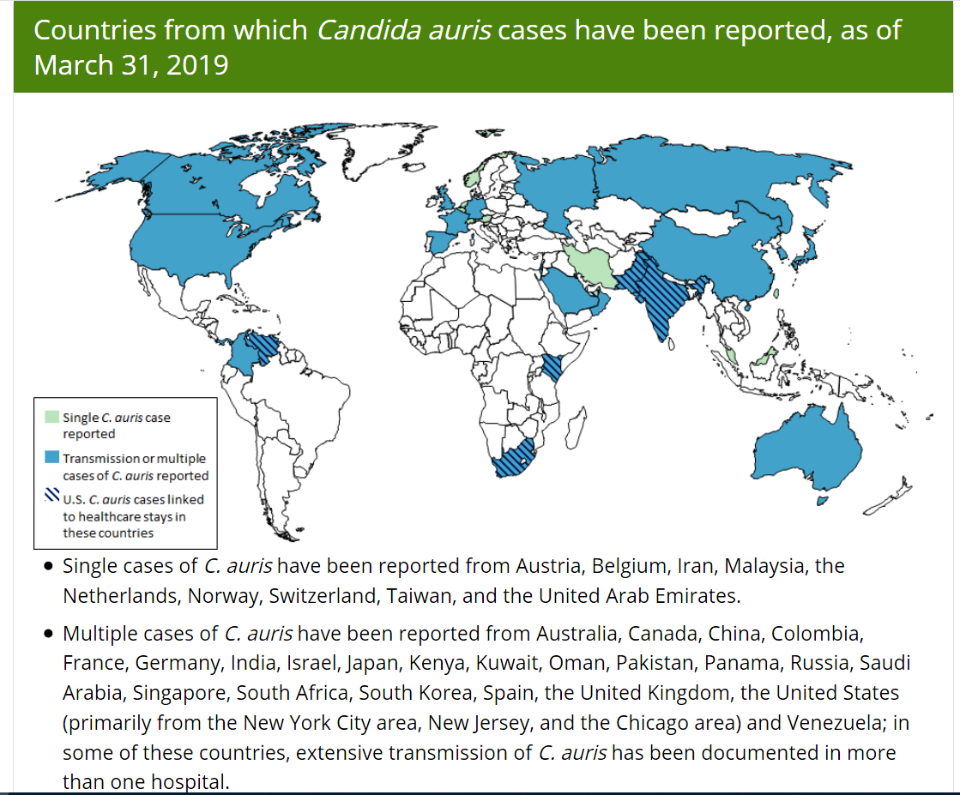

Slide 56
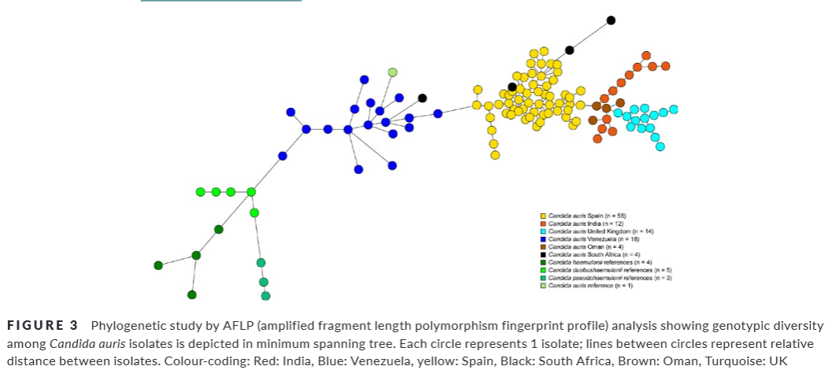

Slide 57
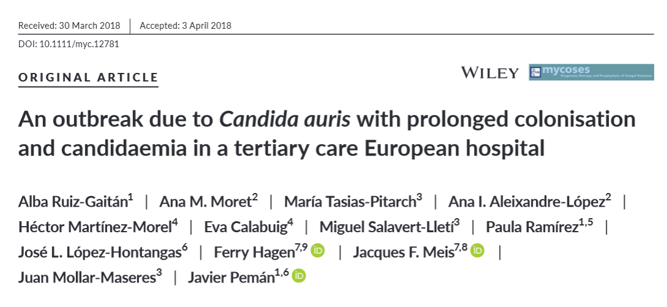

Slide 58
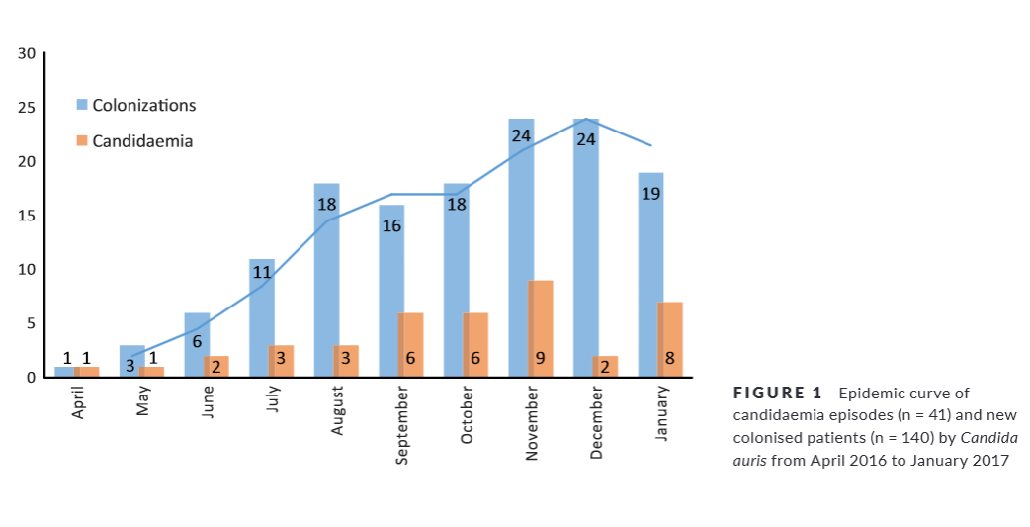

Slide 59
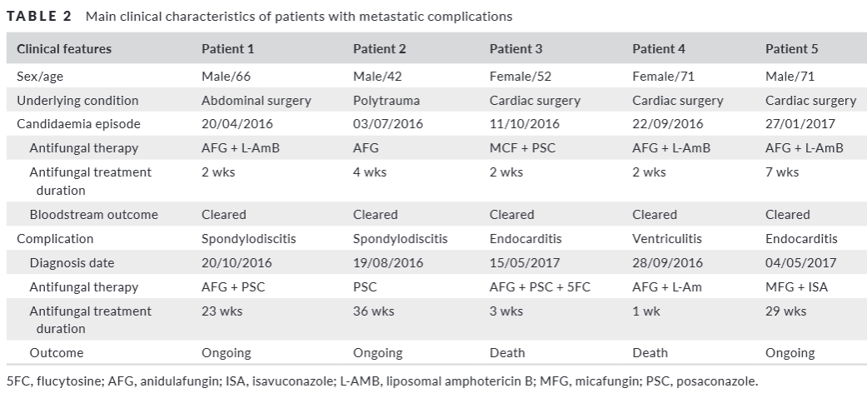
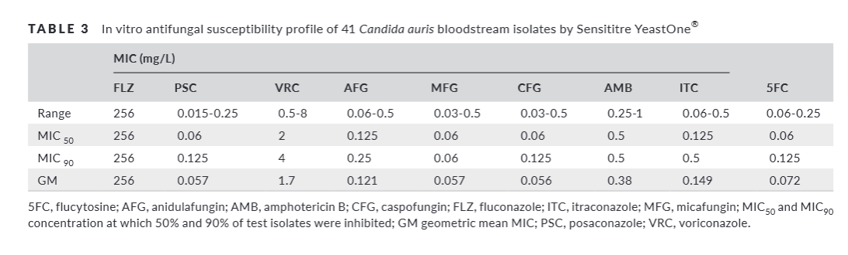

Slide 60
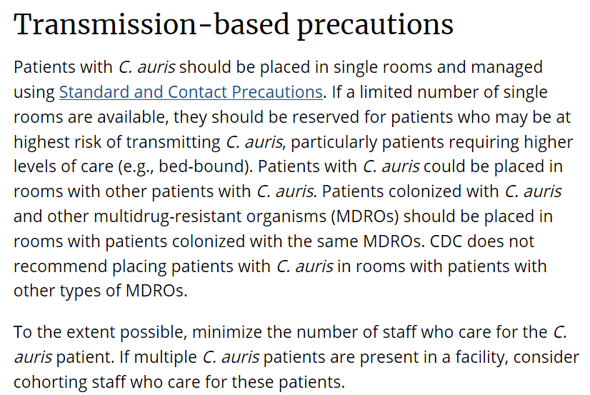

Slide 61
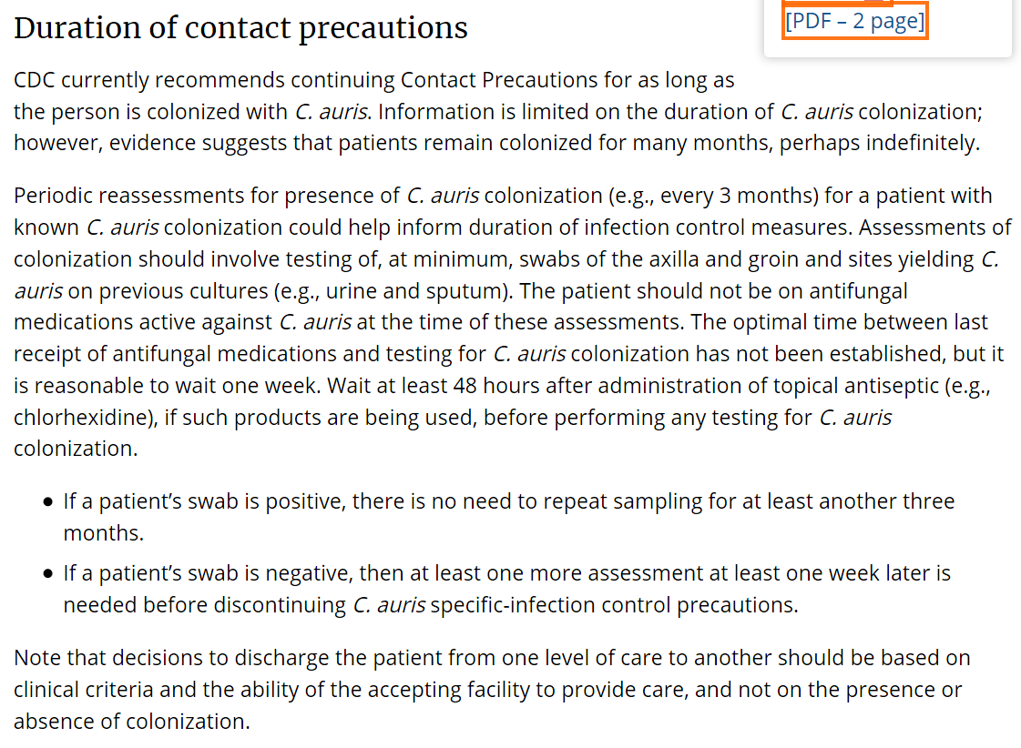

Slide 63
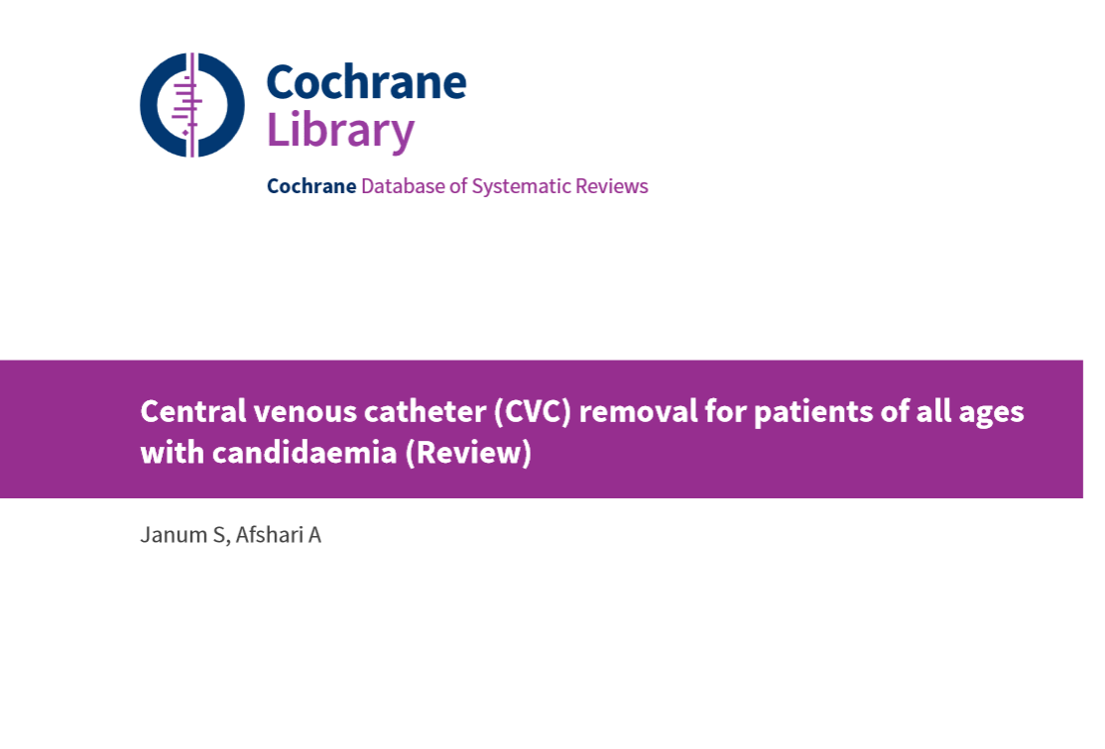

Slide 64
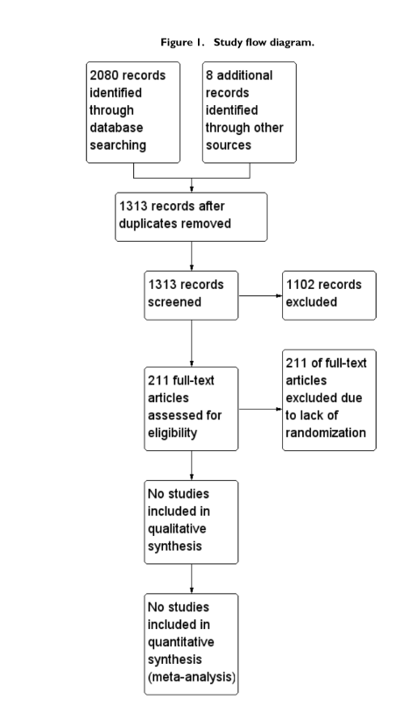

Slide 65
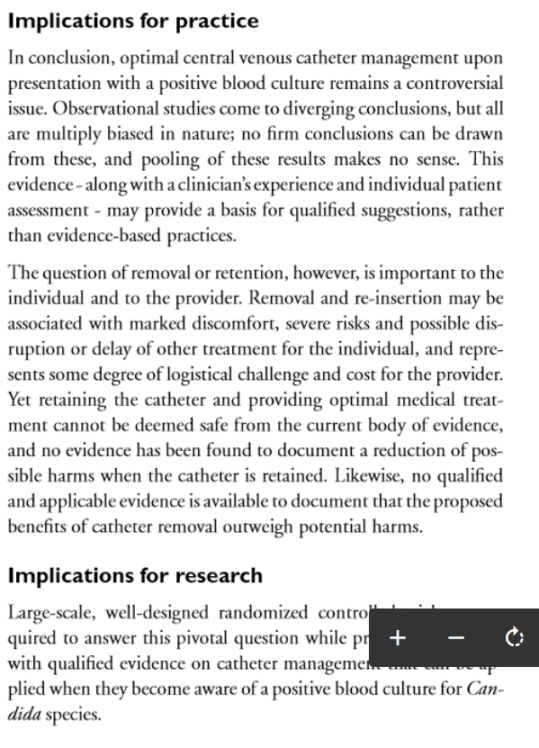

Slide 66
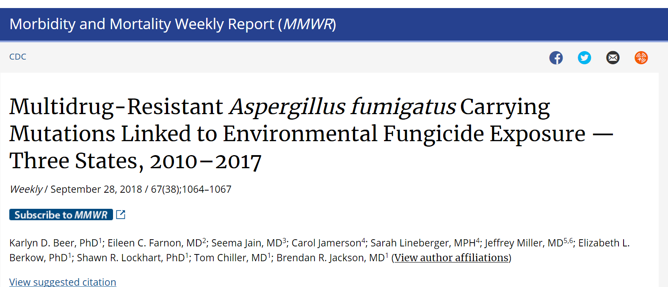

Slide 67
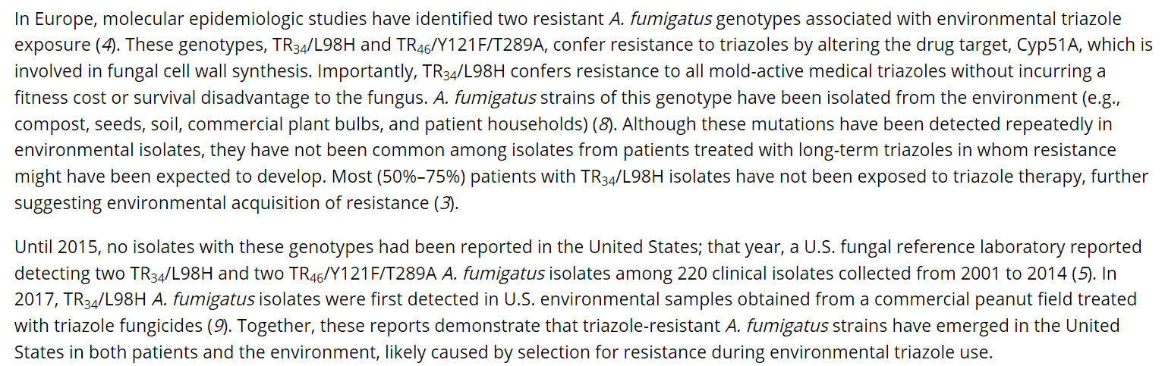

Slide 68
